Slide 1
Value Chain Analysis (VCA)
Problem
How to identify customer care abouts?
Difficulty
Work with an SME
A Value Chain Analysis (VCA) shows the business activities and processes involved in creating a product or performing a service.
A value chain has primary activities and support activities:
Primary activities – activities which directly add value to the customer
Support activities – activities that support primary activities
A value chain analysis can lead to
reduced cost
products better aligned with your customer
current process
Value Chain Analysis
customer
Process assessment
competitors
Assess your product's activities, such as:
Primary activities: Inbound Logistics, Operations, Outbound Logistics, Marketing and Sales, and Services.
Support activities: Infrastructure, Human Resources, Procurement, and Technology.
Analyze the value and cost of these activities.
Model your competitors' value chains.
Model your customer’s assessment of value.
For your activities, determine where you
can reduce costs or improve efficiency
can create a competitive advantage
Copyright © 2022 Dan Zwillinger. All rights reserved.
1
Updated: 202210

Slide 2
Value Chain Analysis – Example
– Buying a hamburger at a fast food restaurant
The customer understands, and values, the primary activities.
The value chain identifies potential opportunities. A customer may pay a premium for
better materials (e.g., fresh ingredients)
better production (e.g., faster product delivery)
better delivery (e.g., on-site or home delivery)
an easier ordering process (e.g., phone app)
the ability to have special orders.
The customer (likely) does not care about where, how, or by whom the cooking is done, nor how the needed materials are acquired.
From the Value Chain, we can identify:
improvements (make these)
costly processes (reduce these)
Copyright © 2022 Dan Zwillinger. All rights reserved.
2

Slide 3
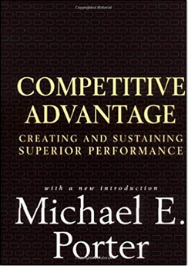
Value Chain Analysis – Notes
Slide 1
Slide 2
The value chain concept was invented by Harvard Business School Professor Michael Porter in his book The Competitive Advantage: Creating and Sustaining Superior Performance.
There are things that a customer cares about, and things that a customer does not care about. The goal is to
add value to the things that the customer cares about
Reduce the cost of things the customer does not care about
Think of this as being all about the customer’s “hamburger experience.”
When buying a hamburger, a customer cares about the things on the top line – these add value to the hamburger experience.
The customer recognizes that the support activates need to be performed. But does not care about the how or where they are done – they do not influence the hamburger experience.
Copyright © 2022 Dan Zwillinger. All rights reserved.
3

