Slide 1
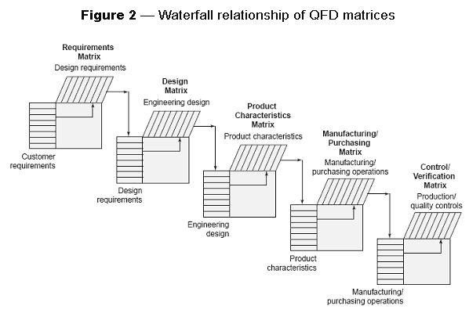
Voice of the Customer (VOC)
Difficulty
Problem
How to delight a customer?
Some training required
The Voice of the Customer (VOC) represents the customer’s thinking:
Customer (external)
Voice of the customer
(VOC) creation
Wants
Don’t wants
Functions
Features
Customers (internal)
VOC flows through the value stream:
Customer to (e.g., NASA)
customer to (e.g., Bus Develop)
customer to (e.g., Systems Eng)
customer to (e.g., Hardware)
customer to (e.g., DFMA team)
…
VOC
Identify the product and its external customers.
Identify the customers along the value stream.
For each customer – find product attributes
A great product is one that results in __?
A great product is one that is ________?
A great product is one that has_______?
Problems in similar products_________?
Determine improvement priorities.
Traceability of VOC – perhaps via QFDs – ensures VOC alignment
VOC is part of a product’s “chorus”
VOB – Voice Of the Business
VOC – Voice Of the Customer
VOCO – Voice Of the COmpetitor
VOTE – Voice Of the Environment
https://asq.org/quality-resources/qfd-quality-function-deployment
Copyright © 2022 Dan Zwillinger. All rights reserved.
1
Updated: 202207

Slide 2
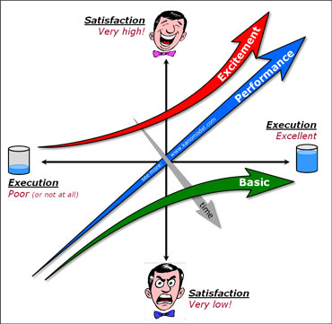
VOC – Example – Assessments and Car Seat Belts
Customer dimensions include satisfaction and functionality.
VOC determines a customer’s level of each.
The Kano model – showing functionality versus satisfaction – shows that, over time, “delighters” become “must haves”.
Three ways a customer responds to an offering:
Excitement – the WOW factor in a product/application
Performance – the more of it, the better
Basic – each of these is must have
https://kanomodel.com/
Example: car seat belts
1950’s – car seat belts are exciting – wow!
1960’s – car seat belts indicate performance – one of many high end features
1970’s – car seat belts are a must have – can’t buy a car without them
Copyright © 2022 Dan Zwillinger. All rights reserved.
2

Slide 3
VOC – Notes
Slide 1
Slide 2
VOC is the key to delighting customers – both the “big C” (external) customers and the “little c” (internal) customers
VOC is part of a product’s “chorus” representing the Business, the Customer, the Competitor, the Environment
VOC can be captured via surveys, focus groups, customer interviews, …
The input to a QFD often comes from a VOC.
Customer’s want a product capability and they also want to be “wowed”. So need to address all aspects of customer satisfaction – as well as meeting the customer specifications.
Note that, over time, what did “wow” a customer will fail to elicit that same response.
For example, seat belts in cars were once exciting, now they are mandatory.
Copyright © 2022 Dan Zwillinger. All rights reserved.
3

