Slide 1
Nominal Group Technique (NGT) / Multivoting
Problem
How to crowd source a response to options?
Difficulty
Easy to use
Nominal Group Technique (also called Multivoting) uses a crowd’s wisdom to quickly prioritize a list of items (e.g., problems or issues)
Typically:
  List has 10 or fewer items.
  Each person gets 3-5 votes
Multivoting Process
List of items
Knowledgeable team
Prioritized items
Create a list of items.
Every team member is given some number of “votes”
Each team member votes for the items they consider most important
  They can spread their votes out or apply all their votes to a single item.
The total number of votes of each item becomes the priority ordering.
  Have team discussion if there are unusual votes (e.g., one person puts all their votes on one item)
Example: 5 topics, 4 people (each with different colored dots), 3 votes/person
Copyright © 2022-2024 Dan Zwillinger. All rights reserved.

Slide 2
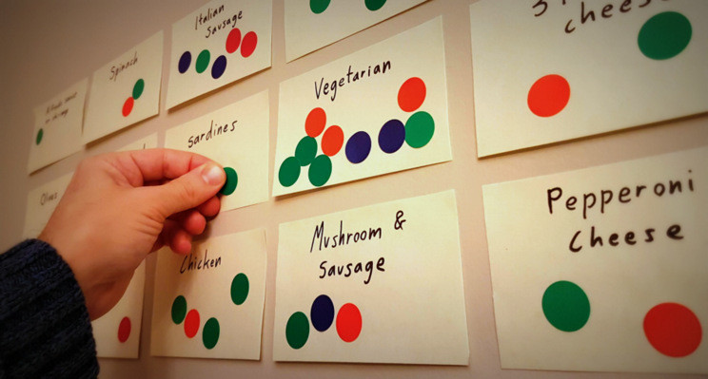
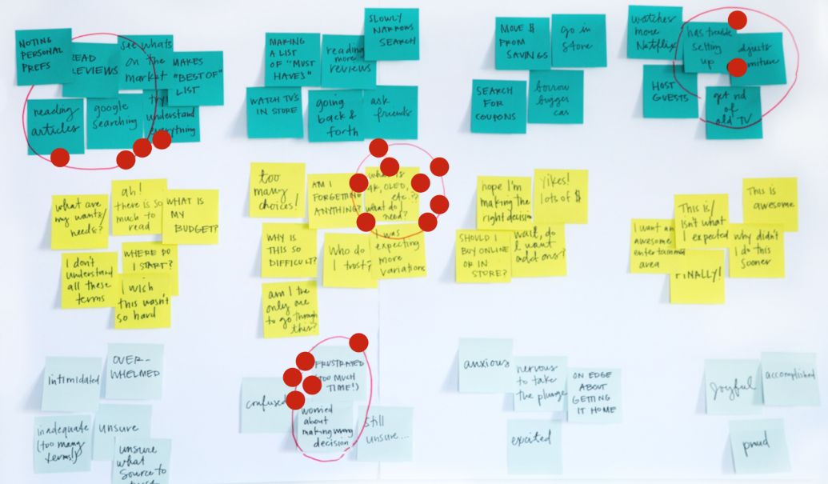
NGT – Examples
Figures (with permission)
https://dotmocracy.org/
https://www.nngroup.com/articles/dot-voting/
Here, a team is choosing what types of pizza to have for lunch. In this case, the number of dots may determine how many pizzas of each type to order.
A typical situation, a team’s votes are on only a few of many alternatives. Here, with 12 items, only 4 items have any votes.
The number of votes is {8, 6, 4, 2}. If only two projects are supported, then the projects with 8 and 6 votes are the ones to pursue.
Copyright © 2022-2024 Dan Zwillinger. All rights reserved.

Slide 3
NGT – Notes
Slide 1
Slide 2
NGT can be used in many different circumstances.
NGT does not replace detailed data gathering and analysis. It is mostly useful for a quick response, such as choosing what to have for a team lunch, or to reduce a large collection of items down to a small collection.
The “wisdom of the crowd” requires that the team be knowledgeable about the topics in the list.
As in the second example, each person’s votes can be the same color.
As both examples show, NGT works well if the list is on a wall, and each vote is a physical sticky dot. (Sticky notes can also be used.)
Copyright © 2022-2024 Dan Zwillinger. All rights reserved.

