Slide 1
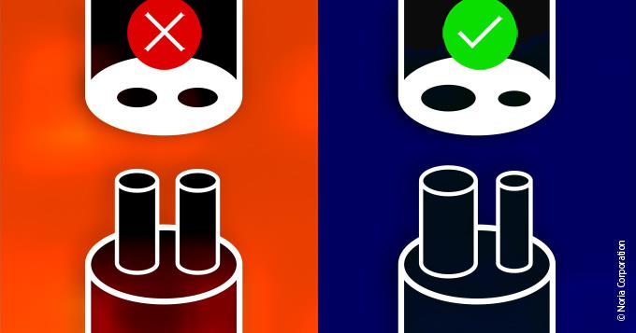
Mistake-Proofing / Error-Proofing (Poka-Yoke)
Problem
How to mitigate potential mistakes?
Difficulty
Some training required
Mistake-Proofing is identifying and correcting problems as close to the source as possible.
Mistake-Proofing is useful for maintenance, operations, production, and servicing.
Existing design
Mistake
Proofing
process
Improved design
Design paradigms
Implement the following principles (as applicable)
Eliminate – remove task/part that allowed errors
Replace – use a more reliable process
Prevent – change task/part to make errors impossible
Facilitate – make work easier to perform
Detect – identify & resolve before further processing
Mitigate – minimize the effects of errors
https://www.reliableplant.com/poka-yoke-31862
Automobile examples
Unleaded gas tank opening
Gas cap tether preventing loss
Car doors lock at 18 mph
Car key cannot be removed unless car is in “park”
Other Examples
Sink overflow outlet
Elevators don’t shut doors on people
Dryer stops when door is opened
Opening a file drawer locks other drawers
Copyright © 2022-2024 Dan Zwillinger. All rights reserved.

Slide 2
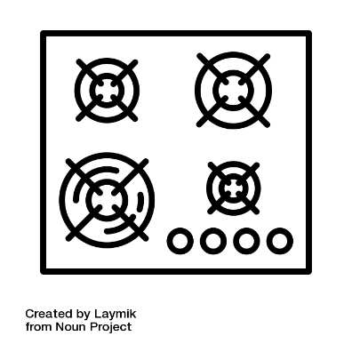
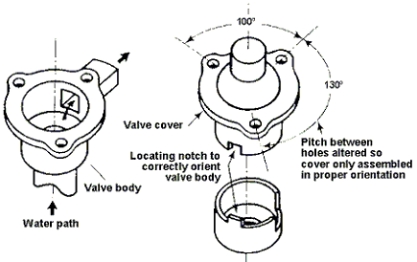
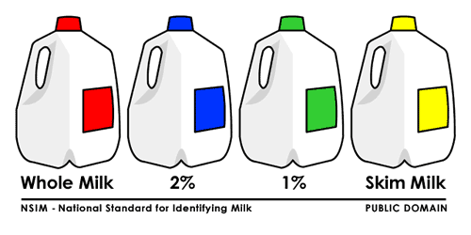
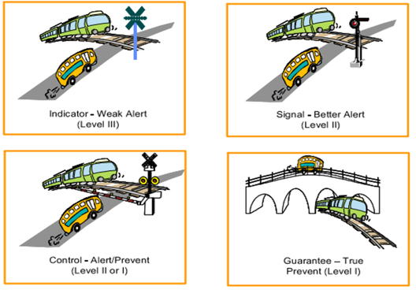
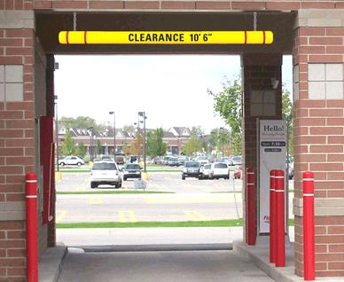
Mistake-Proofing – Examples
Prevent – Make parts as symmetric or as anti-symmetric as possible
Facilitate – Which dial turns on which stove burner?
https://thenounproject.com/icon/stove-top-1474551/
Detect – Milk containers can use color to indicate fat content
https://www.npd-solutions.com/mistake.html
http://www.aleanjourney.com/2011/05/changing-visual-standards-causes.html
Mitigate – To insure cars will fit in a garage with a low clearance, use a go/no-go gauge at the entrance.
Prevent – Different ways to avoid train/car collisions
https://www.parkinglotsafetysolutions.com/height-guard-clearance-bars.html
https://x.com/seanessee/status/633354935908888576
Copyright © 2022-2024 Dan Zwillinger. All rights reserved.

Slide 3
Mistake-Proofing – Notes
Slide 1
Slide 2
Mistake-proofing is about creating processes where mistakes can't happen. If not possible, then the goal is to mitigate the effect of mistakes.
Many products have built in mistake-proofing, and we are likely not aware of it.
The picture shows an electrical plug which – with two equal sized inserts – can be inserted upside down; which can be bad. Making the inserts different sizes prevents the plug from being inserted upside down.
There are 6 standard ways to eliminate or reduce the effects of errors.
“Mistake-proofing” is also called “error-proofing.”
There are books of pictures showing Poka-Yoke in practice – they are fun to look at!
Copyright © 2022-2024 Dan Zwillinger. All rights reserved.

