Slide 1
Gage R&R
(Reproducibility & Repeatability)
Problem
Hot to assess a measurement system?
Difficulty
Work with an SME
Measurement system to be analyzed
Components
Operators
A Gage R&R (GRR) study finds the measurement error in a measurement system.
It addresses measurement system precision (it does not address accuracy).
Gage R&R
Process
Measurement system adequacy
Process
Determine standard that must be met
Example: AIAG = Automotive Industry Action Group
Specify measurement strategy
Example: 10 parts & 3 operators & 3 measurements each
Specify how samples are obtained
Example: “randomly” or “sequentially”
Obtain samples
Obtain measurements
Perform analysis of data and make conclusions
Use of a software package is recommended!
Document the results
Measurement variance includes
The product variation
The equipment variation (repeatability)
The operator variation (reproducibility)
There are different Gage R&R approaches
ANOVA approach
AIAG approach
EMP approach (“evaluating the measurement process”)
GRR Types
Crossed GRR: each operator measures each part
Nested GRR: only one operator measures each part
Copyright © 2022-2025 Dan Zwillinger. All rights reserved.

Slide 2
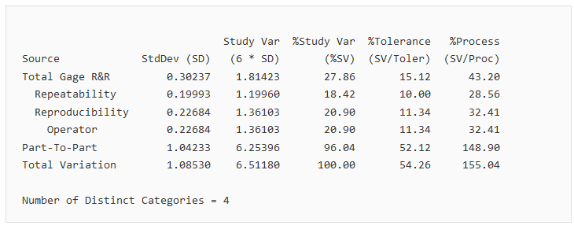
Gage R&R – Example – Sample output from Minitab
This table was created by Minitab
Inputs: piece number, operator number, measurement value
Key values
%Study Var uses the sample’s standard deviation
%Process uses (historical) process standard deviation
Key error contributions
Number of Distinct Categories (NDC)
NDC is the number of non-overlapping 97% confidence intervals that span the product variation.
Often, require NDC > 5 for study validity.
Example category names
NDC = 3 ➔ {Low, Medium, High}
NDC = 5 ➔ {Very Low, Low, Medium, High, Very High}
What percentage of the allowed tolerance has been used
Conclusion: Since this value is between 10% and 30%, the measurement system is marginally acceptable
Copyright © 2022-2025 Dan Zwillinger. All rights reserved.

Slide 3
Gage R&R – Notes
Slide 1
Slide 2
Precision and accuracy are different. Precision might be given to 5 decimal places, while the accuracy only has 1 decimal place.
Gage R&R is about precision of a measurement system, as measured by
repeatability (run the machine two times and obtain the same result)
reproducibility (have two operators obtain the same result)
There are many different approaches to obtain a Gage R&R result.
A G&G analysis requires statistics.
Most statistical packages have Gage R&R capabilities (e.g., Minitab).
Help from a SME is recommended.
Output from statistical packages is fairly standardized.
Usual outputs include the “total Gage R&R” a well as the “repeatability” and “reproducibility” components making up the total Gage R&R.
One output is the “Number of Distinct Categories” (NDC). This is the number of categories that the measurement system can distinguish between. If a measurement system can statistically distinguish between {very small, small, medium, …}, then it is more capable than a measurement system that can only distinguish between “small” and “large.”
There is threshold value that the Gage R&R value should meet (typically 10%) for a measurement system to be deemed “acceptable”.
Recommended web sites for additional information
https://quality-one.com/grr/
https://www.goskills.com/Lean-Six-Sigma/Resources/Gage-rr
Copyright © 2022-2025 Dan Zwillinger. All rights reserved.

