Slide 1
Design for Manufacturing & Assembly (DFMA)
Problem
How to make products easy to construct?
Difficulty
Work with an SME
Design for Assembly (DFA)
is concerned with reducing product assembly cost
Design for Manufacturing (DFM)
is concerned with reducing overall part production cost
Preliminary design
Design for Manufacturing & Assembly Process
Improved design
Team
Methodically apply the DFMA principles
Minimize the number of parts
Minimize the use of fasteners
Standardize
Avoid difficult components
Use modular subassemblies
Use multifunctional parts
Minimize reorientations
Use self-locating features
Avoid special tooling
Provide accessibility
Minimize operations & process steps
DFMA has many benefits
Minimizing the number of parts and extra sizes reduces inventory and confusion during assembly
DFMA optimizes trade-offs between assembly, part, and life cycle costs.
Asymmetric part requires alignment
Symmetry part makes assembly easier
Copyright © 2022 Dan Zwillinger. All rights reserved.
1
Updated: 202210

Slide 2
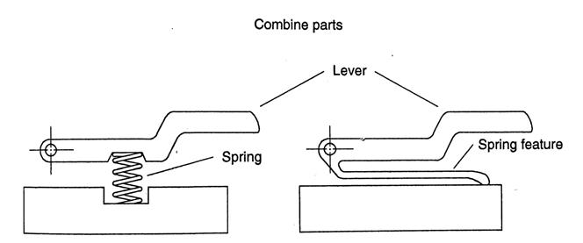
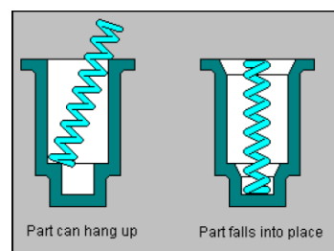
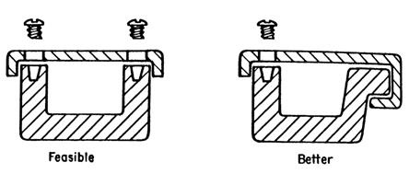
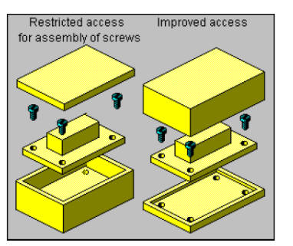
DFMA – Examples
Reduce number of components
Make parts self-aligning
Improve access
Figure credits
https://mae.ufl.edu/designlab/DFMA%20Tips/DFMA%20Tips.htm
https://cpn-us-w2.wpmucdn.com/sites.gatech.edu/dist/2/334/files/2017/03/PD-DFMA.pdf
Copyright © 2022 Dan Zwillinger. All rights reserved.
2
Updated: 202203

Slide 3
DFMA – Notes
Slide 1
Slide 2
DFMA has a set of principles, each reduces the cost of a product’s manufacturability and assembly.
DFMA can be key to profitability.
While the DFMA principles are all simple, and sound simple, seeing examples is the best way to understand their intent.
Asymmetric parts are bad since they may need to be re-aligned during assembly; symmetric parts do not have that issue.
While applying the DFMA principles is straightforward, having a DMFA SME review your improved design is always useful – you may have missed some improvement opportunities.
Several simple examples
Reduce number of components
Top left example: reduces number of parts and eliminates assembly step
Bottom left example: reduces number of parts and may improve assembly
Make parts self-aligning
Top right example: Self-aligning parts speed up assembly
Improve access
Bottom right example: Having an improved access when assembly will speed up assembly
Copyright © 2022 Dan Zwillinger. All rights reserved.
3
Updated: 202203

