Slide 1
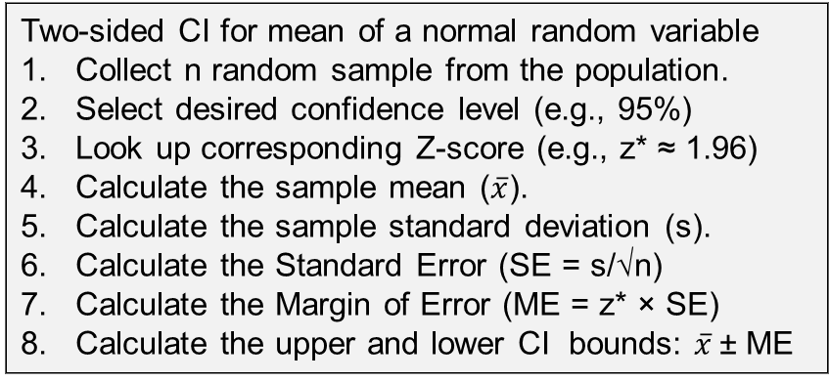
Confidence Intervals
Problem
How to estimate the range for a population parameter?
Difficulty
Some training required
Statistics
A confidence interval (CI) is a range of values likely to contain a population parameter.
A confidence level defines a CI; common values are 90%, 95%, and 99%.
A higher confidence level or a smaller sample size results in a wider CI.
Each set of data analyzed creates a different CI.
Type of data
Sample data
Confidence level
Confidence Interval
Process
Confidence interval
Two-sided CI for mean of a normal random variable
Collect n random sample from the population.
Select desired confidence level (e.g., 95%)
Look up corresponding Z-score (e.g., z* ≈ 1.96)
Calculate the sample mean ($\overline{x}$).
Calculate the sample standard deviation (s).
Calculate the Standard Error (SE = s/√n)
Calculate the Margin of Error (ME = z* × SE)
Calculate the upper and lower CI bounds: $\overline{x}$± ME
Copyright © 2025 Dan Zwillinger. All rights reserved.

Slide 2
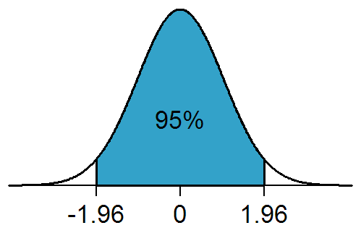
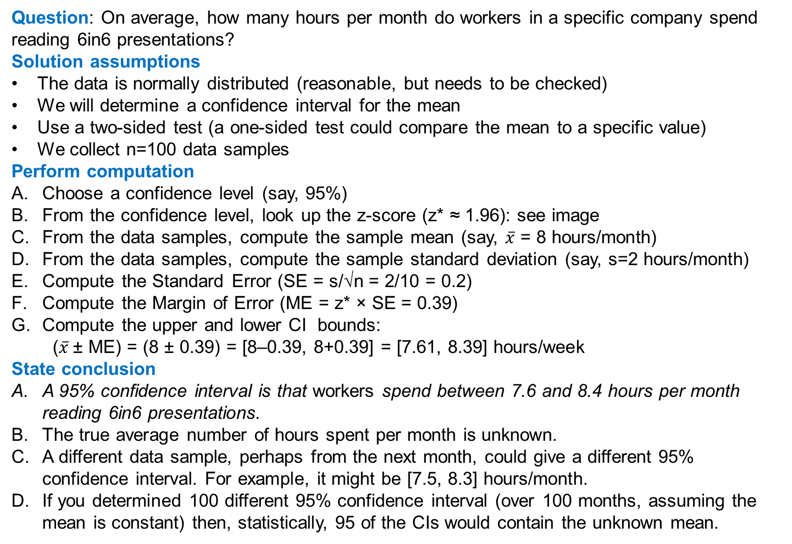
Confidence Intervals – Example
https://commons.wikimedia.org/wiki/File:NormalDist1.96.png
Question: On average, how many hours per month do workers in a specific company spend reading 6in6 presentations?
Solution assumptions
The data is normally distributed (reasonable, but needs to be checked)
We will determine a confidence interval for the mean
Use a two-sided test (a one-sided test could compare the mean to a specific value)
We collect n=100 data samples
Perform computation
Choose a confidence level (say, 95%)
From the confidence level, look up the z-score (z* ≈ 1.96): see image
From the data samples, compute the sample mean (say, $\overline{x}$ = 8 hours/month)
From the data samples, compute the sample standard deviation (say, s=2 hours/month)
Compute the Standard Error (SE = s/√n = 2/10 = 0.2)
Compute the Margin of Error (ME = z* × SE = 0.39)
Compute the upper and lower CI bounds:
  ($\overline{x}$± ME) = (8 ± 0.39) = [8–0.39, 8+0.39] = [7.61, 8.39] hours/week
State conclusion
A 95% confidence interval is that workers spend between 7.6 and 8.4 hours per month reading 6in6 presentations.
The true average number of hours spent per month is unknown.
A different data sample, perhaps from the next month, could give a different 95% confidence interval. For example, it might be [7.5, 8.3] hours/month.
If you determined 100 different 95% confidence interval (over 100 months, assuming the mean is constant) then, statistically, 95 of the CIs would contain the unknown mean.
Copyright © 2025 Dan Zwillinger. All rights reserved.

Slide 3
Confidence Intervals – Notes
Slide 1
Slide 2
CIs have a nuanced interpretation. Many people misunderstand what a CI represents.
Much CI information on the web is wrong. For example: a 95% confidence level
  does not mean that the true value has a 95% probability of being within the calculated 95% CI.
  does not mean that 95% of the sample data lie within the confidence interval.
Confidence intervals depend on the type of data, the number of data points, and whether a one-sided or two-sided CI is desired.
Pros:
  A CI is easy to interpret.
  A CI is useful in decision-making.
  A CI provides a range of possible values for a population parameter
Cons:
  A CI uses a subjective confidence level
  A CI does not guarantee the parameter lies within the interval.
We chose to use a two-sided test. A one-sided test would be appropriate to compare the mean against a single value. For example, this would answer “On average, do workers spend more than 8 hours per month reading 6in6 presentations?
If, in fact, you had data for two months (and the mean stayed constant) then you could compute a single confidence interval using all 200 data points.
Recommended web sites for additional information
https://stattrek.com/estimation/confidence-interval
https://www.calculator.net/confidence-interval-calculator.html
Copyright © 2025 Dan Zwillinger. All rights reserved.

