Slide 1
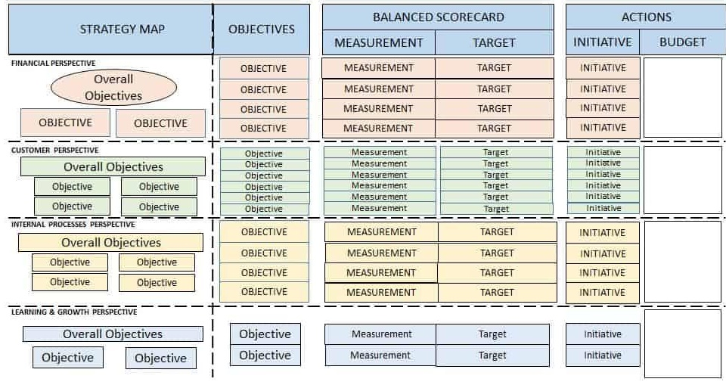
Balanced Scorecard (BSC)
Problem
How to manage an organization’s strategy?
Difficulty
Work with an SME
The Balanced Scorecard (BSC) is a framework for tracking and managing an organization’s strategy.
A BSC has four connected perspectives. Financial goals: What do shareholders want? Customer goals: What do customers want? Process goals: What should we be better at? People (or learning and growth, or innovations, or organizational capacity) goals: How can we create more value?
A strategy map is a 1 page depiction of a BSC with connections between the perspectives.
Lagging and leading metrics
BSC
Process
Business strategy
Improvement Projects
Define the Mission, Vision, and Values.
Define Strategic Priorities, the top-level goals (e.g., client relations, operations, product)
Define the Four Perspectives (in priority order): Finance, Customer, Process, and People.
Define the Business Goals supporting the perspectives. Create cause and effect relations; the lower perspectives’ goals explain how to achieve the higher perspective goals.
Describe each goal’s Rationale, for later review.
Define Leading (success goals) and Lagging (achieved results) metrics for each goal.
Only leading metrics can be influenced; it can be challenging to identify them.
Define initiatives to execute the strategy.
Flow the information down with local strategy maps aligned with higher level strategy maps.
https://www.smartsheet.com/balanced-scorecard-examples-and-templates
Copyright © 2022 Dan Zwillinger. All rights reserved.
1
Updated: 2022010

Slide 2
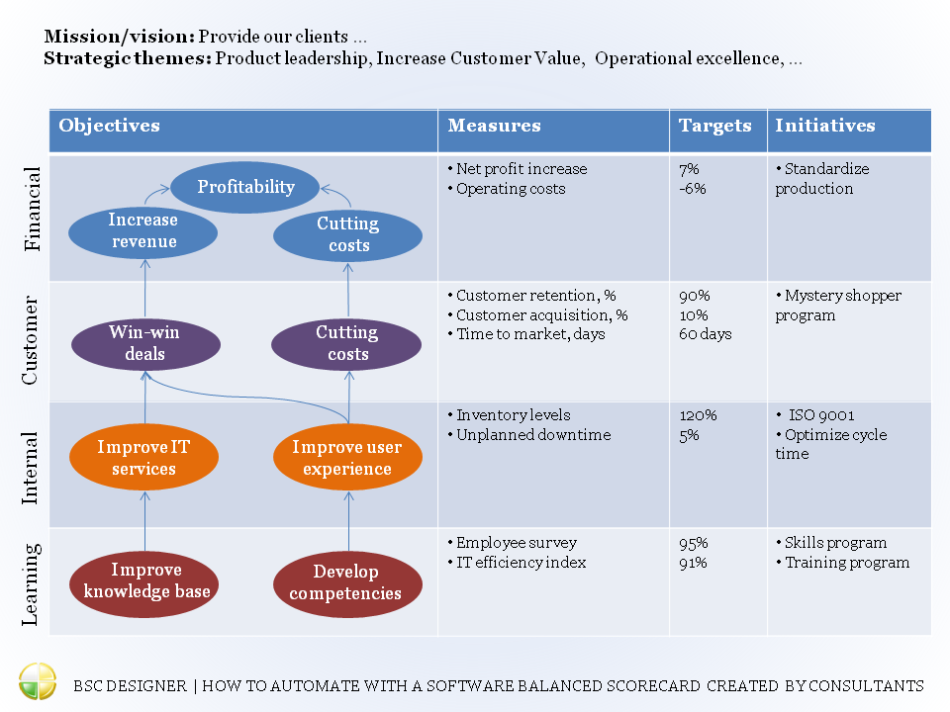
BSC – Example - Generic
These are trailing metrics
How to achieve objectives
Four perspectives
https://bscdesigner.com/wp-content/uploads/2016/10/bsc-example-by-bsc-designer.png
Perspective objectives are connected and flow up
A leading metric would be percentage of employees with new competency training.
Copyright © 2022 Dan Zwillinger. All rights reserved.
2

Slide 3
BSC – Notes
Slide 1
Slide 2
The BSC was developed in 1992 by David Norton and Robert Kaplan.
While other perspectives could be used, experience has shown that Financial, Customer, Process and People work well.
Typically, a BSC is developed by management, stakeholders, and employees, ensuring collective responsibilities.
Benefits of the BSC
Improved organizational alignment and communication
Improved strategic planning and performance tracking
Mapping strategy into understandable performance measures.
It helps a company invest internally, in processes, infrastructure, and technology for better performance.
Potential Strategy Mapping mistakes
Having unconnected goals
Focusing on Operational goals
Not documenting the rationale
Only using lagging metrics
Having Too Many Goals
Mixing Goals and Metrics
A fairly generic strategy map is shown.
There are many generic maps available on the web for different industries including nonprofits and government agencies (both of which are not profit driven).
Copyright © 2022 Dan Zwillinger. All rights reserved.
3

