Slide 1
Analytical Hierarchy Process (AHP)
Problem
How to choose among multiple alternatives?
Difficulty
Work with an SME
Goal
AHP Process
Selected alternative
The Analytic Hierarchy Process (AHP) is a method for making decisions under multiple and complex criteria.
AHP is easy to use since stakeholders only perform pairwise comparisons, assigning values 1-9.
The pairwise comparisons are performed between all the criteria, between each set of sub-criteria, and between the alternatives.
Criteria
Alternatives
Define the goal.
Define the criteria (simple or hierarchical)
Define the alternatives.
Determine the priorities amongst the criteria, sub-criteria, and alternatives (for each criteria) using pairwise comparison.
Use SW to convert pairwise comparisons into priorities and confirm consistency.
Use SW to combine priorities and obtain overall priorities for the alternatives.
Use SW to perform a sensitivity analysis.
Copyright © 2022 Dan Zwillinger. All rights reserved.
1
Updated: 2022010

Slide 2
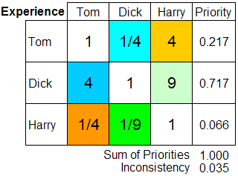
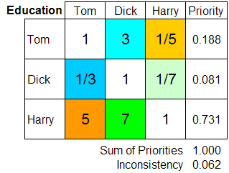
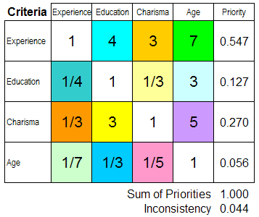
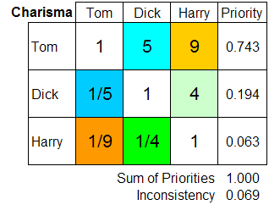
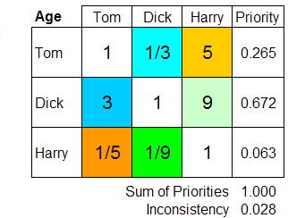
AHP – Example – choose a leader – from Wikipedia
From https://en.wikipedia.org/wiki/Analytic_hierarchy_process_%E2%80%93_leader_example
Want to choose a leader
Have 4 criteria: experience, education, charisma, age
(2) The stakeholders compare the alternatives, pairwise, for each criteria.
(1) Compare the criteria pairwise to determine their priorities. (If “A” is preferred over “B” by a factor of N, then “B” is preferred over “A” by a factor of 1/N)
Team pairwise results – process inputs
Priorities found by SW
Always sums to one
Small, good!
Team pairwise results – process inputs
(3) Weight the alternative priorities, for each of the criteria, by that criteria's priority.
sum of each row’s values
Dick is the best choice
largest value
0.119 = 0.547*0.217
0.392 = 0.547*0.717
Copyright © 2022 Dan Zwillinger. All rights reserved.
2

Slide 3
AHP – Notes
Slide 1
Slide 2
AHP was developed by Thomas L. Saaty in the 1970s.
AHP computations involve linear algebra (eigenvalues) and are best left to specialized software packages. (There are many.)
Any values 1-9 can be used for Intensity, not just {1,3,5,7,9}.
The computations are easier to show than to describe.
A data inconsistency occurs when the pairwise comparisons indicate that “A” is preferred to “B”, and “B” is preferred to “C”, yet “C” is preferred to “A”.
AHP software usually determines an overall inconsistency; if this value is large than the pairwise comparisons should be reviewed.
Like probabilities, priorities are numbers between zero and one, without units.
AHP can handle multiple criteria and, using stakeholder input, determine the relative importance of each of the criteria. For example, when buying a truck both the cargo carrying capacity and the number of seats may not be equally important.
The example has a simple set of criteria, with no hierarchy.
There are three computational steps:
Determine the criteria priorities
Determine priories of the alternatives for each of criteria
Combine the above results
The best option has the largest overall value. If the two options with the largest values were numerically close, then other techniques might be used to decide between them.
Copyright © 2022 Dan Zwillinger. All rights reserved.
3

