Slide 1
The Eight Disciplines of Problem Solving (8D)
Problem
How to solve a special cause problem?
Difficulty
Work with an SME
8D
Process
Root cause
The 8 Disciplines, also known as the 8D process, is a team-oriented approach to correct recurring problems.
8D has more complexity than the PDCA (plan-do-check-act) approach and less complexity than six sigma’s DMAIC.
Special cause problem
Containment action
Team
Corrective action
Select the problem to be addressed
Execute the classic 8D steps (with D0 added):
D0: Prepare and plan for 8D.
D1: Select a knowledgeable team.
D2: Quantify the problem: who, what, where, when, why, how, and how many.
D3: Develop and implement a containment plan to isolate the customer from the problem.
D4: Determine the problem root cause(s).
D5: Identify the corrective actions and test.
D6: Implement the corrective actions.
D7: Take preventive measures to prevent recurrence of this and similar problems.
D8: Congratulate the team.
Copyright © 2022-2024 Dan Zwillinger. All rights reserved.

Slide 2
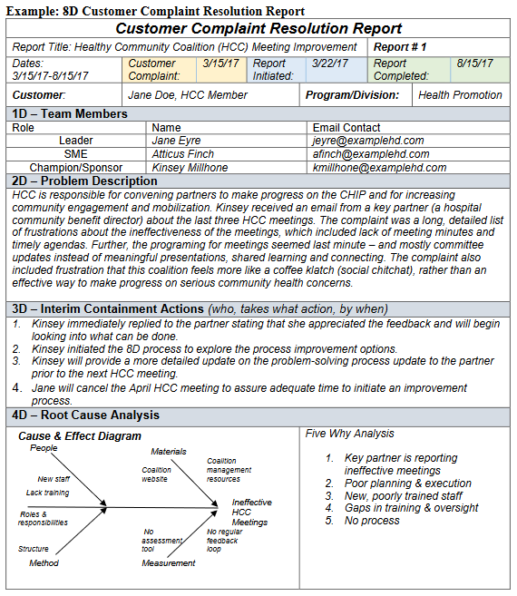
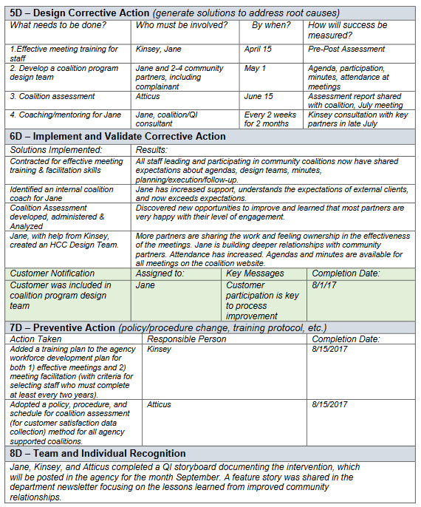
8D – Example – Illustrative “8D Report”
From http://www.phf.org/resourcestools/Documents/8D_Customer_Complaint_Resolution_Report.pdf (with permission)
Copyright © 2022-2024 Dan Zwillinger. All rights reserved.

Slide 3
8D – Notes
Slide 1
Slide 2
8D focuses on variation due to special causes, that is, solving a specific problem. Six Sigma focuses on common cause variation, and improving capability.
Goals of the 8D process include:
Quickly responding to a customer complaint (e.g. a failed component at the customer site).
Addressing steps D0 through D3, and reporting to the customer, within three days.
Benefits of 8D include
It is simple and effective.
It includes root cause analysis, which should prevent the specific problem from arising again.
It uses a cross-functional team.
Use of 8Ds is standard in the automotive industry.
An 8D report documents the results of each step in the 8D process.
The example shown was taken from a web site.
Recommended web sites for more information
https://www.rolls-royce.com/~/media/Files/R/Rolls-Royce/documents/sustainability/value-chain-competitiveness/9-vcc-how-to-carry-out-problem-solving.pdf
http://www.phf.org/resourcestools/Documents/8D_Customer_Complaint_Resolution_Report.pdf
Copyright © 2022-2024 Dan Zwillinger. All rights reserved.

