Slide 1
5S Process of Lean
Problem
How to remove distracting clutter?
Difficulty
Easy to use
5S is a organization method.
5S is based on 5 Japanese words whose transliterations start with the letter “S.” These correspond to 5 English words: Sort, Straighten, Shine, Standardize, and Sustain.
5S efforts impress customers.
5S improves workplace safety, quality, morale, and throughput.
“cluttered”
environment
5S
Process
“uncluttered”
environment
Continuously perform the following actions
Sort: Remove unneeded items from the area.
Straighten: Make a place for everything and put everything in its place.
Shine: Clean and inspect everything in the area.
Standardize: Every process has a standard.
Sustain: Continue 5S – without being told.
Japanese
English
Meaning
Seiri
Seiton
Seiso
Seiketsu
Shitsuke
Sort
Straighten
Shine
Standardize
Sustain
Organize
Order
Clean
Standards
Discipline
Copyright © 2022 Dan Zwillinger. All rights reserved.
1
Updated: 202208

Slide 2
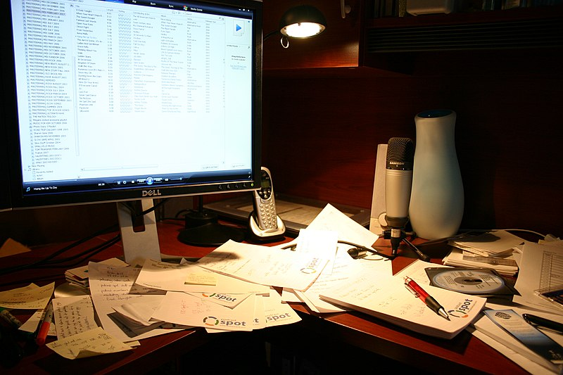
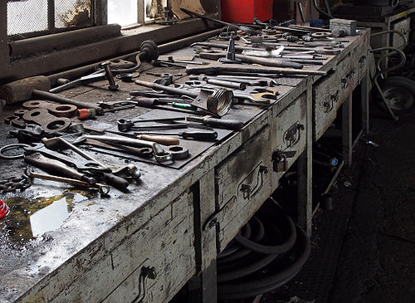
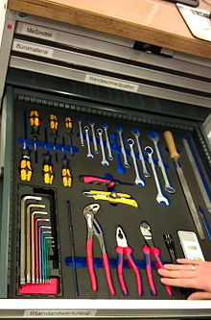
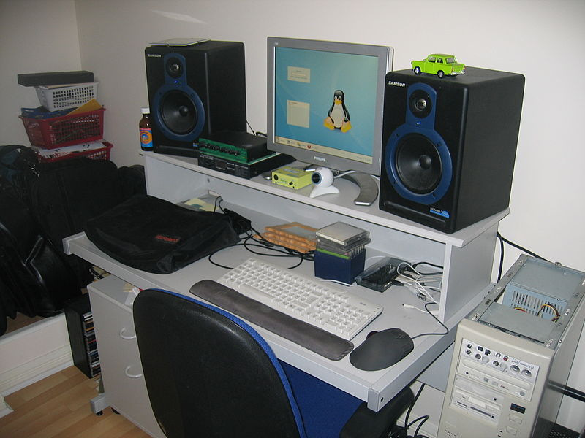
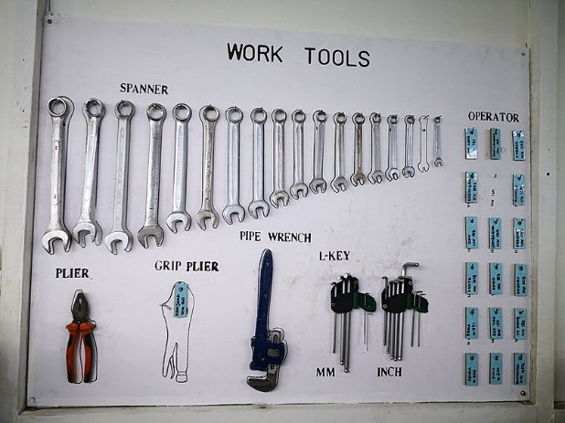
5S - Examples
Figure Credits
https://commons.wikimedia.org/wiki/File:Part_of_my_messy_desk_(430672681).jpg
https://commons.wikimedia.org/wiki/File:Tawalker's_home_studio_gear_(2007).jpg
https://commons.wikimedia.org/wiki/File:5S_Tools_drawer.jpg
https://commons.wikimedia.org/wiki/File:Papan_Bayangan_(Shadow_Board).jpg
https://www.wikiwand.com/en/Workshop
Popular 5S application areas
Office environments: especially desks and storage
Manufacturing: especially kitting of tools and components
Copyright © 2022 Dan Zwillinger. All rights reserved.
2

Slide 3
5S – Notes
Slide 1
Slide 2
The 5S process creates uncluttered environments.
People work “better” in uncluttered environments. In uncluttered environments, people know where inputs come from, where their tools are, and where the outputs go.
There are five steps, each starts with the letter “S” {Sort, Straighten, Shine, Standardize, Sustain}
Some companies have 6S or 7S processes by adding {Safety, Security}
The 5 S’s can be interpreted as {Organize, Order, Clean, Standards, Discipline}
The concept is to continuously go through the 5 steps, over and over again.
It is easy to see how 5S works – before and after photos can be dramatic!
Popular 5S application areas are office environments and manufacturing areas.
It is easier to work when tools are laid out by function, easily available, and it is easy to see if any tools are missing.
Copyright © 2022 Dan Zwillinger. All rights reserved.
3

